Slide 1
QA Induction for Fresher’s
Created By: QA Team
Approved By: PE Head
Date of Release: August 2016
Version No: 2.0
Duration: 4 Hrs

Slide 2
Starters
01. Trainer’s Introduction
02. Participant’s Introduction
- Name
- View on Quality

Slide 3
Agenda
Introduction – Concepts of Quality
QMS, Its Components & Navigation
Deliver (Global QMS)
KM Portal – Best Practice/Sample Records Database
Tools Quality Implementation at Capgemini
Our Continual Quality Journey…
Industry Standards
QA Team
Walkthrough of Basic Templates
Case Studies & Games
Notes:
Here is the agenda for today’s session.
We will be going through some generic terminologies, Quality terminologies, QMS & Its components, QMS Portal, The Global QMS i.e Deliver, The Best practice /sample records database KM Portal, We will look at the Capgemini recommended tools, Capgemini Quality Journey, Industry Standards, India QA Department – Its structure & services, Walkthrough of some basic templates, why to capture efforts, defects etc…
We will also be taking you through some case studies and games related to QMS.

Slide 4
Introduction – Concepts of Quality

Slide 5
Why Quality is important?
Notes:
Note: To play this Video, you need to have a flash player installed!
Let us see an example video of Europe & Italy and understand what is the difference between both the countries shown here.
<Play the video>
In this video, Europe has a systematic/disciplined approach in what they are doing. Whereas for Italy, it is not. Hence people of Europe are getting better results in what they are doing than compared to Italy.
So to get a better results, whatever we do, we need to do it in a systematic / disciplined approach.
QMS helps in having the systematic/disciplined approach in the organization.

Slide 6
Why Quality is important Contd..
Can be corrected while it was built..
Doing it Right, the First Time and Every Time
But can we afford to correct after it has crashed?
Notes:
Note: Explain using the aeroplane example, how important it is to “Doing it Right, The First Time and Every Time”.

Slide 7




Scenario : Developing a Software App (WhatsApp)
Requirements/Planning:
Identify Customer (internet users) requirements.
Requirement Analysis/Defining:
Analyze the different requirements from users & finalize the requirements.
Coding (Building):
Using the designs & software technologies, coding will be done
Design the Software App:
High level and low level complete software app design is done.
Notes:
With an example & we will try to understand how a software application is developed in a software industry.
Let us consider we are developing a very familiar mobile application “WhatsApp”.
Firstly, we identify & gather all the requirements for the mobile app, what is the need of people.
We analyze all those needs & finalize them.
Then design the application based on the requirements. Here we will identify what technology to be used, how to place the all the functions, security requirements etc..
Once the design is done. We will start with the coding / development of the mobile app.

Slide 8




Scenario : Developing a Software App (WhatsApp)
Coding(different functionalities):
Coding might happen at functionalities level. Like one part is assigned to one team and another part to another team.
Product Integration:
Assemble the product with its different components.
Testing:
Test all the product components after the product is integrated with all its components.

Slide 9


Scenario : Developing a Software App (Whats App)
Deployment:
Deploy the Product to Production Environment.
Internet user downloads and uses the software app.
With this scenario, we understood that, there is a sequence of stages involved in the development of a software product.
Here, Requirements/Planing, Requirement Analysis/Defining, Design, Coding, Testing, Deployment etc.. these are WhatsApp software development life cycle stages.

Slide 10
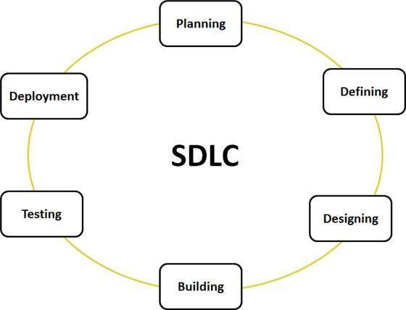
Software Development Life Cycle (SDLC) & CG Methodologies
In a previous scenario, we have seen the WhatsApp Software development life cycle with its different stages.
The software development life cycle is a framework defining tasks performed at each step in the software development process.
A typical Software Development life cycle consists of the following stages:
Stage 1: Planning and Requirement Analysis
Stage 2: Defining Requirements
Stage 3: Designing the product architecture
Stage 4: Building or Developing the Product
Stage 5: Testing the Product
Stage 6: Deployment in the Market and Maintenance
Notes:
Note: Explain the definition of the SDLC and its phases considering the WhatsApp software Development app.
Following are the most important and popular SDLC models followed in the industry:
Waterfall Model
Iterative Model
Spiral Model
V-Model
Big Bang Model

Slide 11
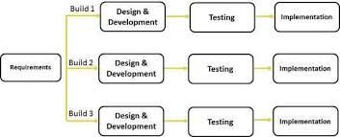
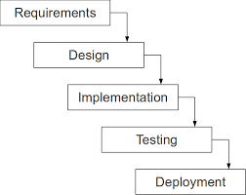
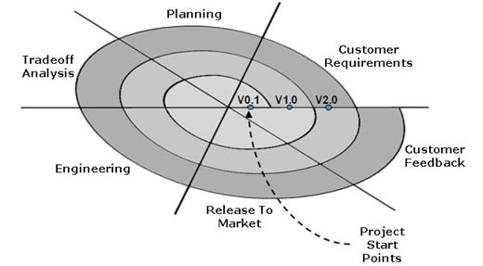
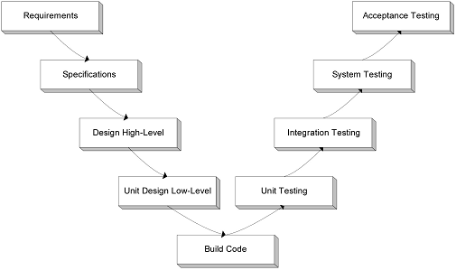
Various Life Cycle models & Methodlogies in Software
Most Important and Popular SDLC models:
Waterfall Model
Iterative Model
Spiral Model
V-Model
Methodologies:
UPM – Unified Project Management
India Agile Process Framework - Agile
iSAP – Industrialized SAP - SAP
TMAP – Testing
OUM – Oracle Unified Methodology - Oracle
Notes:
Note: Explain the different SDLC models using the screenshots.

Slide 12
Role Play on SDLC
Example Scenarios:
OLA App development
UBER App development
Make My Trip design.

Slide 13
Generic Terminologies
What is a Product?
Software or substance that is manufactured/developed for sale.
Example: A Software app (WhatsApp), Smart Phone. Tennis Ball, A Computer etc..
What is a Defect?
Non-conformance of a product with the specified requirements, or non-fulfillment of user expectations.
Example: WhatsApp messages not getting delivered, Smartphone camera not working,
What is an Issue?
An issue is a problem related to a project/product that is currently occurring.
Example: Developer doesn't have the skill to fix the defect.
What is a Risk?
A risk is an uncertain event or condition that, if it occurs, has a positive or negative impact on a project's objectives. Risks can become issues if they are not addressed properly.
Example: Requirements elicitation is not done properly, might result into more design defects.
Notes:
Note : Consider the WhatsApp software development scenario to provide the examples to the terminologies.

Slide 14

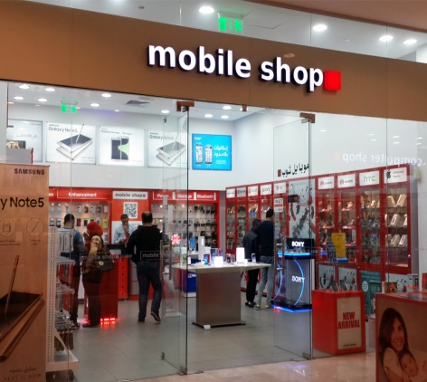

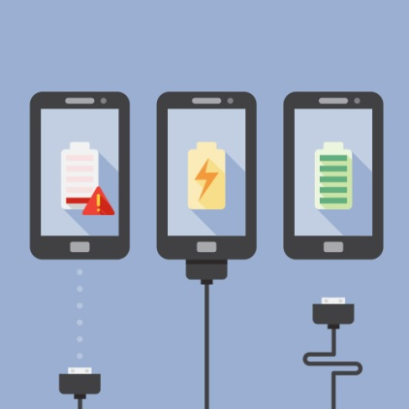



Scenario : Alex’s Smartphone
Alex is in need of a cell phone. He goes to a mobile shop and buys a smart phone. He gets 1 year warranty on his phone. He also understands that the smart phone screen may get scratch while using, so he gets his phone screen covered with a screengaurd. After some days he noticed that the battery is getting discharged very quickly. And after a few more days, he noticed that he is not able to take photos and camera is not working. As he has a warranty on his phone, he takes his phone to the customer service desk and gets it fixed for free of cost. Alex is happy now that his phone is working properly.

Slide 15
Generic Terminologies
What is a Service?
A valuable action, deed, or effort performed to satisfy a need or to fulfill a demand.
Example: Alex’s Smartphone repair.
What is an Incident?
Unplanned interruption to a service, a reduction in the quality of a service.
Example: Alex’s Smartphone camera is not working.
What is an Problem?
A problem is a condition often identified as a result of multiple incidents that exhibit common symptoms.
Example: Alex’s gets the battery replaced however after few days he again gets the same issue.
Notes:
Note: Consider Alex’s Smartphone scenario to provide the example to the terminologies.

Slide 16
What is Quality?
Two Views of Quality
1
2
Producer’s View: Meeting Requirements
Customer’s View: Fit for Use
Quality has attributes such as
Capability
Usability
Performance
Install-ability
Maintainability
Scalability
Security
Quality is the degree to which any product or service possesses a desired combination of attributes, to satisfy the stated and implied needs.
People have found many ways to define Quality:
A degree of excellence
Conformance to requirements
Totality of characteristics which act to satisfy a need
Fitness for use
Fitness for purpose
Freedom from defects
Delighting customers etc…
Notes:
The entire training revolves around the term Quality. So what does Quality mean?
Different people have different views of quality, resulting in various definitions of the term Quality.
To understand these different views of Quality, let us see a simple scenario.
A varied range of Mobile phones are available in the market today. The producers view of Quality is all about having some basic features inbuilt in the product before they start selling in the market. The quality check involves checking basic characteristics of the product like Performance, Reliability, Scalability, Security, Usability, Capability, Install-ability and Maintainability.
Coming to the customers view of quality, consider a scenario wherein you go to buy a mobile phone. The salesman shows you a branded mobile phone with many features, 5Mbps camera and low price. Someone standing next to you might immediately buy this mobile phone as he wanted a branded mobile phone with basic features and low price. You are still not satisfied with the device as your requirement is to buy a mobile with a high end camera. Hence Customer’s view of quality comes into picture here which talks about making the product ‘fit for use’ as per the customers requirements.
There are various definitions of the term Quality, but to summarize we can say that: Quality is the degree to which any product or service possesses a desired combination of attributes, to satisfy the stated and implied needs.
===============Quality Attributes==============
Capability is something which will indicate what is your business and what you are capable of doing to the client. Example: Development of Mobile Software App.
Maintainability is the ability of the system to undergo changes with a degree of ease. Example: Mobile Software App can be enhanced easily to include a new function.
Usability defines how well the application meets the requirements of the user and consumer. Example: User needs a calender function in his phone & The mobile app or mobile has the calender inbuilt.
Performance is an indication of the responsiveness of a system to execute any action within a given time interval. Example: Phone Battery performance, Internet speed etc..
Scalability is ability of a system to either handle increases in load without impact on the performance of the system, or the ability to be readily enlarged.
Security is the capability of a system to prevent malicious or accidental actions outside of the designed usage, and to prevent disclosure or loss of information.
Example: Mobile virus prevention softwares. Damage protection glasses etc..

Slide 17



Benefits of Quality
Benefits of quality to clients
Improved services
Improved choices
Expectations met or exceeded
Client oriented employees
Friendlier atmosphere
Benefits of quality to employees
Pride in services delivered
Job satisfaction
Improved communications
Streamlined work processes
Happier clients
Strong client relationships
Benefits of quality to the organization
Improved/expanded services
Client oriented employees
Improved client relations
Improved community relations = better political relations
Lower costs/cost contained
Improved funding
Organization Benefits

Slide 18
Quality Terminologies
What is Quality Control?
Quality control (QC) is a procedure or set of procedures intended to ensure that a product or performed service adheres to a defined set of quality criteria or meets the requirements of the client or customer.
What is Quality Assurance?
It is the activity of providing evidence needed to establish confidence among all concerned, that quality-related activities are being performed effectively.
Quality Assurance Is Not Quality Control
Quality Assurance makes sure you are doing the right things, the right way. Quality Control makes sure the results of what you've done are what you expected.
Example: Introducing the testing phase in a process is Quality Assurance, whereas performing the actual testing is a Quality Control.

Slide 19
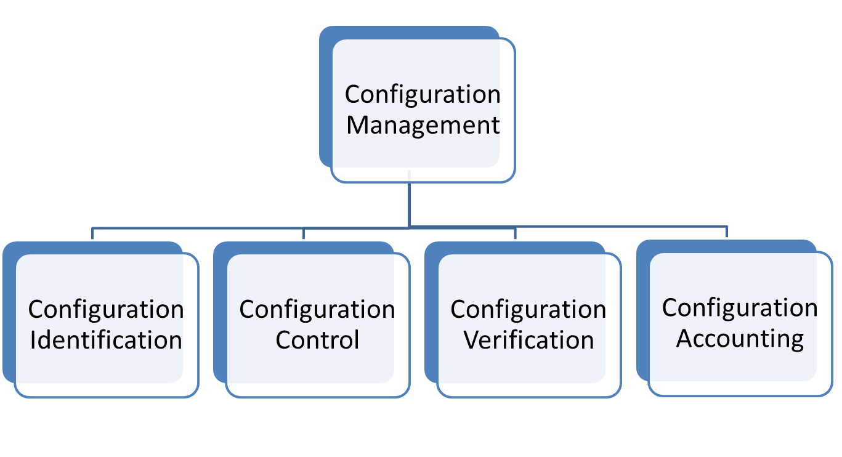
Configuration Management basic concepts
Definition:
Configuration Management manages the components of a software project or system as well as the versions and releases of the system.
Notes:
Note: Let us see what is configuration management and the purpose of it.
The purpose of CM is to establish and maintain the integrity of work products using configuration identification, configuration control, configuration status accounting, and configuration audits.
CM manages the components of a software project along with its versions control, releases etc…

Slide 20
Agenda
Introduction – Concepts of Quality
QMS, Its Components & Navigation
Deliver (Global QMS)
KM Portal – Best Practice/Sample Records Database
Tools Quality Implementation at Capgemini
Our Continual Quality Journey…
Industry Standards
QA Team
Walkthrough of Basic Templates
Case Studies & Games
Notes:
Here is the agenda for today’s session.
We will be going through some generic terminologies, Quality terminologies, QMS & Its components, QMS Portal, The Global QMS i.e Deliver, The Best practice /sample records database KM Portal, We will look at the Capgemini recommended tools, Capgemini Quality Journey, Industry Standards, India QA Department – Its structure & services, Walkthrough of some basic templates, why to capture efforts, defects etc…
We will also be taking you through some case studies and games related to QMS.

Slide 21
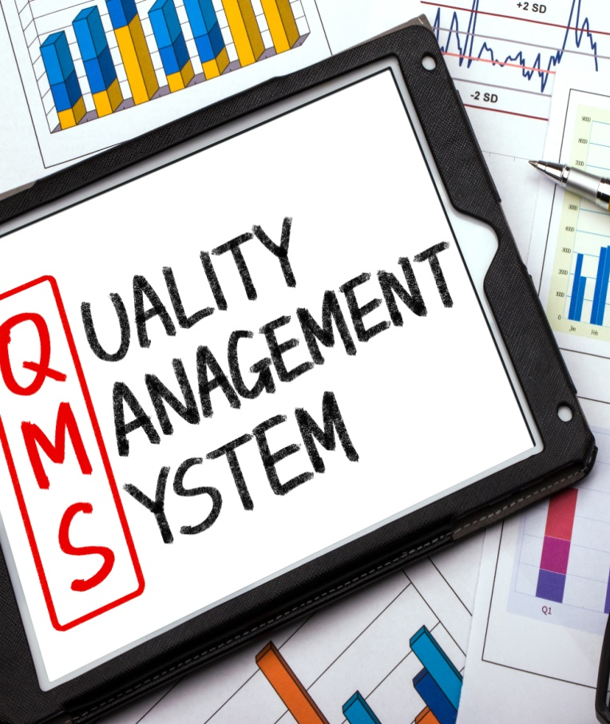
What is Quality Management System (QMS)?
Capgemini India Quality Management System (QMS) provides the systematic approach to meet customer requirements resulting into the desired service or product
It consists of a set of policies, procedures, guidelines, tools, templates and checklists, required for planning and execution of product or service in an organization
It integrates the various internal processes within the organization and intends to provide a process approach for project execution
QMS Path: http://qa.in.capgemini.com

Slide 22
QMS Structure
Quality Policy
Roles & responsibility
Management Reviews
Quality Planning
Level 1
Project Planning & Tracking
Estimation & Risk Management
S/w Engineering Process
Metrics Management
Capgemini India Quality Manual
Level 2
Methods and
processes
S/w Development Plan
Peer Review
Test Log
Metrics Sheet
Level 3
Guidelines, Checklists and
Templates
Senior Management Reviews
Audit Report
Review Log
Status Report
Level 4
Records. Documents validating that the QMS requirements have been met

Slide 23


What is Quality Policy?
A quality policy is a statement issued by management and quality experts to express the quality objectives of the organization, the acceptable level of quality and the responsibilities of team to ensure quality.
Capgemini’s Quality & Service Management Policy –
Capgemini is committed to satisfy customer expectations by delivering solutions and
services through state of the art processes and continual improvement frameworks
in line with contractual, statutory and regulatory requirements.
OTACE:
On Time and At Client’s Expectation
The OTACE Team publishes the Organizational Level OTACE Report
Organizational baseline : OTACE score > = 3.5
E -Val is a Web based tool used to record and report OTACE information across Capgemini India
http://groupeval.capgemini.com/
Notes:
Capgemini’s Quality and Service Management Policy is ‘to always meet or exceed Client Expectations.’
To be in line with the policy, measuring Customer Satisfaction is a key. At Capgemini we measure Customer’s Satisfaction in the form of OTACE which stands for “On Time & At/ Above Client’s Expectation”. Client is responsible for providing this rating on a scale of 1 to 5, 1 being the lowest rating.
OTACE rating has to be published based on the agreed criteria with the Customer.
Organizational Baseline for OTACE is 3.5 and projects are expected to get a rating of 3.5 or above. OTACE Action Plan is to be prepared in case there are any improvement suggestions from customer for any of the agreed criteria, or in case of lower rating.
E -Val is a Web based tool used to record and report OTACE information across Capgemini India.

Slide 24
QMS Components
What is Quality Manual?
Quality manual defines scope and quality management structure. It also include the organization's quality policy and objectives and a highly detailed explanation of the quality control system being used.
Location: Capgemini – India Quality Manual is at India QMS > Processes > Apex Documents > APEX LEVEL DOCUMENTS > CG_India Quality Manual.docx
What is a Process?
A process is a set of interrelated activities that interact to achieve a result.
INPUTS
Interrelated activities
OUTPUTS
CUSTOMER
(Internal or external)
“PRODUCT”
Process
Other Interested
Parties
Notes:
Note:
Talk about what is quality manual, what it contains and where do we find the Capgemini quality manual.
Talk about what is a process using the diagram. Process is a set of interrelated activities happing with certain inputs to it to get a desirable output. Output may be for the internal customer or external customer or any other interested party.

Slide 25


QMS Components Continued…
What is a Procedure?
A fixed, step-by-step sequence of activities or course of action that must be followed in the same order to correctly perform a task.
Example: Procedure for conducting a training program.
What are Tools?
Tools are a set of basic components and accessories that help software development process more efficient.
Example: Project Management Tools, Testing Tools, Defect Tracking Tools etc..13

Slide 26


QMS Components Continued…
What are Roles & Responsibilities?
Roles - Roles are the positions team members assume or the parts that they play in a particular operation or process.
Responsibilities - Responsibilities are the specific tasks or duties that members are expected to complete as a function of their roles.
Capgemini India Roles & Responsibilities can be found at QMS > Processes > Apex Documents > APEX LEVEL DOCUMENTS > CG_Org Roles_Responsibilities.doc
Example: Project Manager – Project Management Activities for the project.
What is a Guideline?
Guidelines typically provide additional optional information on specific subjects.

Slide 27
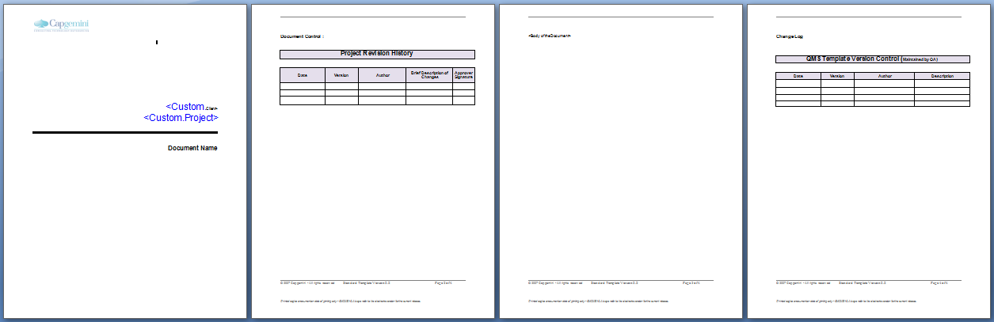

QMS Components Continued…
What is a Template?
It supports work products by providing a pre-defined structure for creating the work product.
Example: A Test Case Template will help to create a Test Case
What is a Checklist?
Checklists identify a series of items those need to be completed or verified. Checklists are often used in reviews such as work product inspections.
Example: Code Review Checklist helps in performing a code review.

Slide 28
QMS Portal Walkthrough

Slide 29
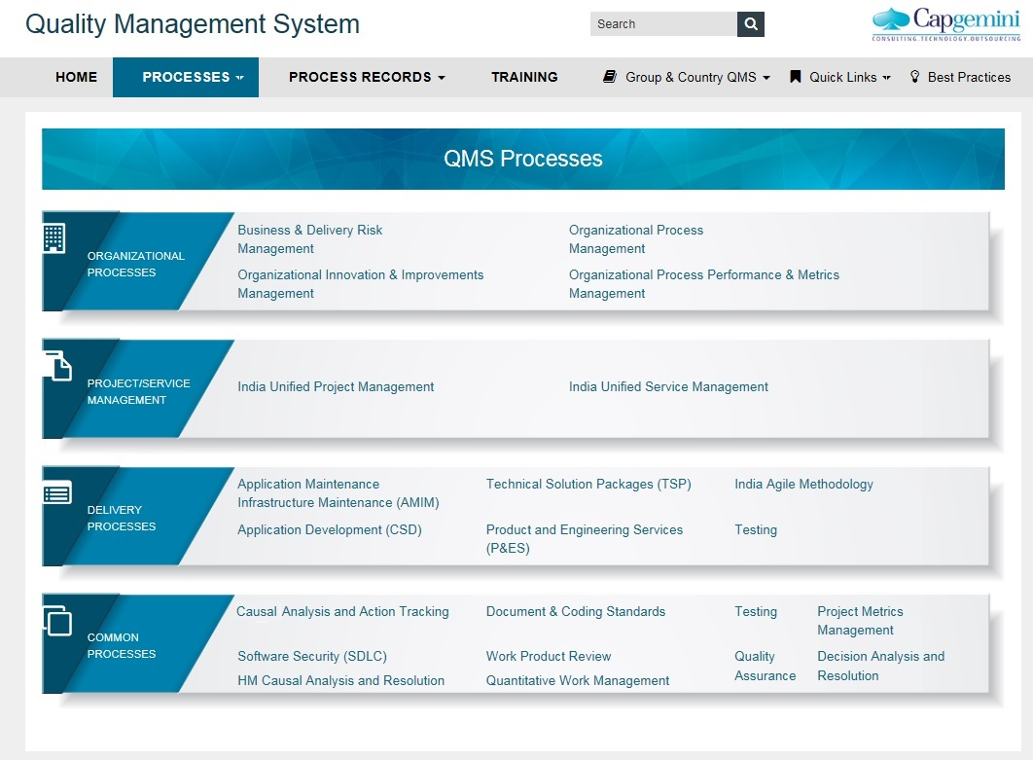
QMS Portal & Its Navigation
Click on QMS processes
References to Organizational Processes
References to TSP Processes
References to Unified Project
Management
References to India Agile Processes
References to AM IM Services
References to Testing Life Cycle
References to CSD Processes
References to Common Processes
References to Global Engineering Services

Slide 30
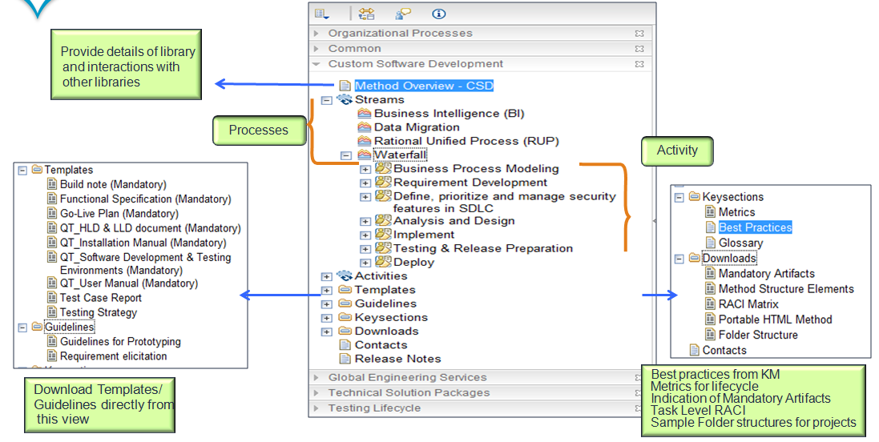
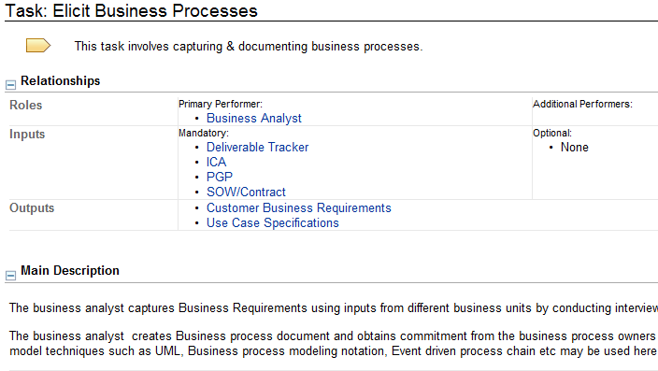
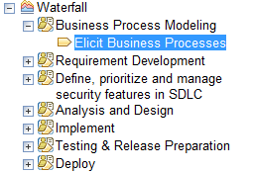
QMS Portal & Its Navigation Continued…
Notes:
Now we will come back to the navigation of each process Library.
The process Library is a comprehensive documents repository consisting of work flow built processes, roles, templates, etc. The following are various components in each of the process libraries.
All process libraries have Method overview section which gives a high level overview of the entire process.
All processes are listed under streams, which are in turn mapped to different activities. Activities are then split into tasks, wherein each task consists of:
- Detailed work instructions
- Primary and Secondary Roles
- Inputs and outputs
Templates and guidelines
Tool Mentors
Different views are provided and templates/ guidelines can be directly downloaded from template view.
Key sections are covered in the end for capturing process wise metrics and links to best practices from KM portal.
Downloads section consists of Mandatory artifacts, Task Level RACI, Sample Folder Structures for projects and Portal HTML method to download the library.

Slide 31
Agenda
Introduction – Concepts of Quality
QMS, Its Components & Navigation
Deliver (Global QMS)
KM Portal – Best Practice/Sample Records Database
Tools Quality Implementation at Capgemini
Our Continual Quality Journey…
Industry Standards
QA Team
Walkthrough of Basic Templates
Case Studies & Games
Notes:
Here is the agenda for today’s session.
We will be going through some generic terminologies, Quality terminologies, QMS & Its components, QMS Portal, The Global QMS i.e Deliver, The Best practice /sample records database KM Portal, We will look at the Capgemini recommended tools, Capgemini Quality Journey, Industry Standards, India QA Department – Its structure & services, Walkthrough of some basic templates, why to capture efforts, defects etc…
We will also be taking you through some case studies and games related to QMS.

Slide 32
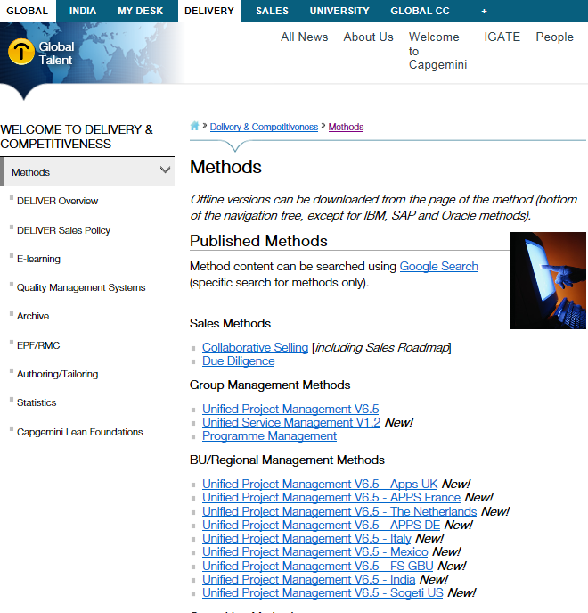
Deliver
DELIVER is the Capgemini Global Methods Environment
DELIVER provides frameworks, methods, techniques and tools for managing and delivering all types of programs, projects and services
It consists of processes for business development, architecture design , application development, package implementation and support services
The DELIVER method to manage projects is called Unified Project Management (UPM), and method to manage services is called Unified Service Management (USM)
India QMS is built based on Deliver methods and is aligned to group processes.

Slide 33
Agenda
Introduction – Concepts of Quality
QMS, Its Components & Navigation
Deliver (Global QMS)
KM Portal – Best Practice/Sample Records Database
Tools Quality Implementation at Capgemini
Our Continual Quality Journey…
Industry Standards
QA Team
Walkthrough of Basic Templates
Case Studies & Games
Notes:
Here is the agenda for today’s session.
We will be going through some generic terminologies, Quality terminologies, QMS & Its components, QMS Portal, The Global QMS i.e Deliver, The Best practice /sample records database KM Portal, We will look at the Capgemini recommended tools, Capgemini Quality Journey, Industry Standards, India QA Department – Its structure & services, Walkthrough of some basic templates, why to capture efforts, defects etc…
We will also be taking you through some case studies and games related to QMS.

Slide 34
KM Portal – Best Practice/Sample Records Database
What is take away from Best Practices data base
How to contribute to Best Practices data base
Delivery
Project is initiated
Project refers to Best practices repository (Trackers, tools etc)
Identifies practices during execution or post release which were uniquely done to achieve results
Project submits Best Practice
Best Practices in KM 3.0
https://km3.capgemini.com/community/616708/home
SME’s evaluates Technical & Tool related Best practice
QA team
Add to QMS as a process
Evaluate best practices for standardization
Trigger for process initiative – Regular process
SEPG evaluates Process related Best practice
Best Practice describes the experience gained when the process is performed
Project fills asset details in Best Practice / Lessons Learnt Submission Form
Project sends the Best Practice / Lessons Learnt form to In, quality.assurance
SEPG evaluates Best Practice / Lessons Learnt and updates Organizational Best Practice / Lessons Learnt Database for process related Best Practices
Notes:
A Best Practice is a technique or methodology which is a take away from a project during its execution. A Best Practice can be reused by other projects to achieve similar benefits.
All Best Practices are available for reference in KM Portal which can be referred by projects during project planning and execution phases.
Projects can also submit technical and process related Best Practices in KM Portal which can act as a reference to other similar projects. The submitted Best Practices related to process, are evaluated by QA team and the accepted best practices gets added to Organizational Best practices database.
The path for KM portal is as displayed on screen.

Slide 35
Agenda
Introduction – Concepts of Quality
QMS, Its Components & Navigation
Deliver (Global QMS)
KM Portal – Best Practice/Sample Records Database
Tools Quality Implementation at Capgemini
Our Continual Quality Journey…
Industry Standards
QA Team
Walkthrough of Basic Templates
Case Studies & Games
Notes:
Here is the agenda for today’s session.
We will be going through some generic terminologies, Quality terminologies, QMS & Its components, QMS Portal, The Global QMS i.e Deliver, The Best practice /sample records database KM Portal, We will look at the Capgemini recommended tools, Capgemini Quality Journey, Industry Standards, India QA Department – Its structure & services, Walkthrough of some basic templates, why to capture efforts, defects etc…
We will also be taking you through some case studies and games related to QMS.

Slide 36
Tools Quality Implementation at Capgemini
Capgemini Recommend Tools are listed in the tabular format
Streams | Capgemini Recommended tools
01 - Project Governance | N2K, Clarity, Team Forge, QPUT,DNA Report, CI portal, A3s
02 - Planning And Financial Management | GREAT, N2K, Clarity,openWorkBench,IN_TimeCard,,Autoprome,Pricing Tool
03 - Resource Management | Clarity,IN_PACE, In_IRW,GRCWEB
04 - Scope And Requirements Management | Team Forge, Requisite Pro
05 - Change Control | Clarity,TeamForge
06 - Risk Management | Clarity,TeamForge,PMTS(Risk Assessment Tool)
07 - Issue Management | Clarity,TeamForge
08 - Client Relationship Management | E-Val
09 - Supplier And Procurement Management | Clarity,TeamForge
10 - Communication Management | Clarity,GIMS+,IN_Visual Management Boards,LVIS , VVM Dashboard,A3s
11 - Infrastructure Management | Clarity,GFS
12 - Configuration Management | Subversion,Sharepoint
13 - Quality Management | Clarity, Rational Functional Tester and Test Manager, IN_CAST, HP Quality Center,CAST,PMTS, Predictive Analysis
14 - Knowledge Management | Team Forge, KM 2.0,Sharepoint
Notes:
Here is the list of Capgemini Recommended Tools which is covered under Infrastructure Management of UPM. Necessary approvals are required for any project specific tailoring on tools .

Slide 37
Agenda
Introduction – Concepts of Quality
QMS, Its Components & Navigation
Deliver (Global QMS)
KM Portal – Best Practice/Sample Records Database
Tools Quality Implementation at Capgemini
Our Continual Quality Journey…
Industry Standards
QA Team
Walkthrough of Basic Templates
Case Studies & Games
Notes:
Here is the agenda for today’s session.
We will be going through some generic terminologies, Quality terminologies, QMS & Its components, QMS Portal, The Global QMS i.e Deliver, The Best practice /sample records database KM Portal, We will look at the Capgemini recommended tools, Capgemini Quality Journey, Industry Standards, India QA Department – Its structure & services, Walkthrough of some basic templates, why to capture efforts, defects etc…
We will also be taking you through some case studies and games related to QMS.

Slide 38
Our Continual Quality Journey…
6 Sigma & LEAN – a continuation of our CMMi journey
We use 6 Sigma & Lean as a vehicle for continuous improvement & innovation; a pre-requisite for us to stay at CMMi Maturity Level 5 [higher level of process-predictability]
ISO 9001: 2000
SW-CMM L5
BS 7799
SAS 70
ISO 27000
ITIL V2
6 Sigma/LEAN
ISO 9001:2000
CMMi v1.2 Dev L5
AS 9100
ITIL V3
CMMI 1.3 ser L5
ISO 20000 -2011
ISO 9001:2008
ISAE 3402 / SSAE 16
AS9100
TL 9000
Sustenance & Continual
Innovation Journey...
2001-2005
2006-2010
2011-2015
2016 onwards
Notes:
The slide shows the quality journey of Capgemini since its Quality Inception in 2001.
QMS is compliant to CMMI Services L5, ITIL V3, AS 9100, TL 9000, ISO 20K and ISO 9K, etc.
Along with these certifications – Capgemini adapts 6 Sigma & Lean as continual improvement methodology.
We will understand each of these standards, models and certifications in brief, in the coming slides.

Slide 39
Agenda
Introduction – Concepts of Quality
QMS, Its Components & Navigation
Deliver (Global QMS)
KM Portal – Best Practice/Sample Records Database
Tools Quality Implementation at Capgemini
Our Continual Quality Journey…
Industry Standards
QA Team
Walkthrough of Basic Templates
Case Studies & Games
Notes:
Here is the agenda for today’s session.
We will be going through some generic terminologies, Quality terminologies, QMS & Its components, QMS Portal, The Global QMS i.e Deliver, The Best practice /sample records database KM Portal, We will look at the Capgemini recommended tools, Capgemini Quality Journey, Industry Standards, India QA Department – Its structure & services, Walkthrough of some basic templates, why to capture efforts, defects etc…
We will also be taking you through some case studies and games related to QMS.

Slide 40


Industry Standards
There are many industry standards / Models like ISO, CMMI, ITIL, Six Sigma, Lean etc..
ISO
The International Organization for Standardization (ISO) is an international standard-setting body composed of representatives from various national standards organizations.
It is responsible for the ISO 9000, ISO 14000, ISO 27000, ISO 22000 and other international management standards.
CMMI
Capability Maturity Model integration (CMMI) is a process improvement model introduced by Software Engineering Institute of Carnegie Mellon University.
Notes:
This slide talks about the different industry standards available and a brief on them.

Slide 41
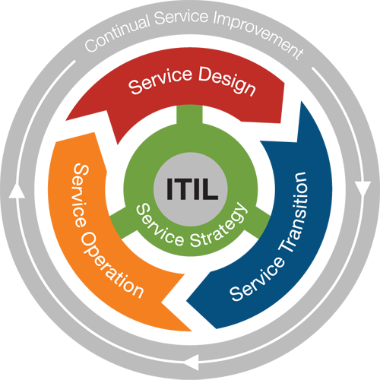
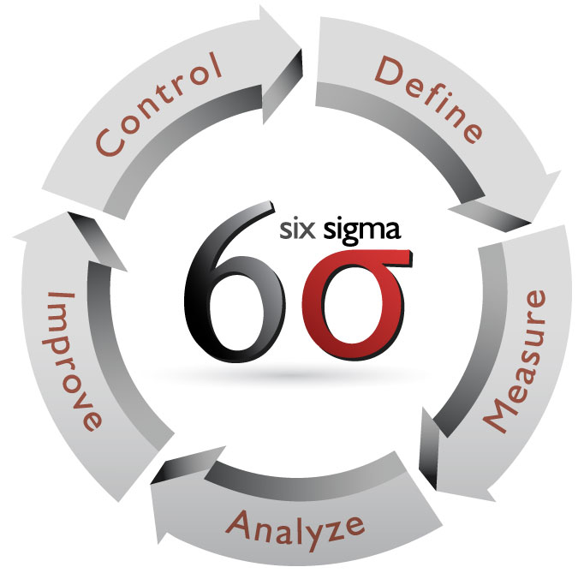
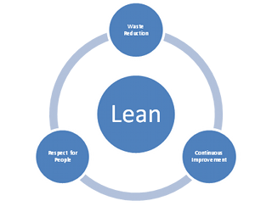
Industry Standards
ITIL
Information Technology Infrastructure Library, is a set of practices for IT service management (ITSM) that focuses on aligning IT services with the needs of business.
Six Sigma
Six Sigma is a disciplined, data-driven approach and methodology for eliminating defects in any process – from manufacturing to transactional and from product to service.
Lean
It is a systematic method for the elimination of waste ("Muda") within a Project life cycle.

Slide 42
Agenda
Introduction – Concepts of Quality
QMS, Its Components & Navigation
Deliver (Global QMS)
KM Portal – Best Practice/Sample Records Database
Tools Quality Implementation at Capgemini
Our Continual Quality Journey…
Industry Standards
QA Team
Walkthrough of Basic Templates
Case Studies & Games
Notes:
Here is the agenda for today’s session.
We will be going through some generic terminologies, Quality terminologies, QMS & Its components, QMS Portal, The Global QMS i.e Deliver, The Best practice /sample records database KM Portal, We will look at the Capgemini recommended tools, Capgemini Quality Journey, Industry Standards, India QA Department – Its structure & services, Walkthrough of some basic templates, why to capture efforts, defects etc…
We will also be taking you through some case studies and games related to QMS.

Slide 43
QA Department
Quality Assurance Department
quality.assurance.in@capgemini.com
We facilitate & Provide on-going support:
Implementation of Quality Assurance standard in all spheres of activity throughout the organization viz. projects and functions.

Slide 44
Org Structure
COO India (Yardi, Ashwin)
QA & Risk Head – Leena Sagar
Delivery Assurance
Delivery Review & Risk Management
Process Engineering
Internal Audit Squad
ISSAE 3402/ Support function
Analytics
Process COE - CATALYST)
OBU Head
Program/ Engagement Manager
Project Manager/SDM
PQL
Team lead
Team Members
Other Towers

Slide 45


QA Services – Facilitation and Ongoing Support
Multiple suggestions will lead to confusion !!
We help you follow the right steps at the right time !!
During Facilitation :
Introducing to QMS
Contract reviews
Sharing best practices
Assistance in process tailoring
Metrics configurations in tools
Etc…
During On-going Support :
Connect with PQL for on-going activities
Monthly project reviews
Support in process improvements
Metrics reviews
Etc..
Notes:
Process facilitation is an important ingredient to the success of a project. There is always a need to guide the project teams to follow the right process. Not just any process - something that helps them achieve the fundamental objectives.
Myth – I will be guided by a process analyst for ALL my process activities
Mythbuster – Busted !! – you have a PQL role in your project who is adequately trained to support the project and project team members on Quality Assurance activities.

Slide 46
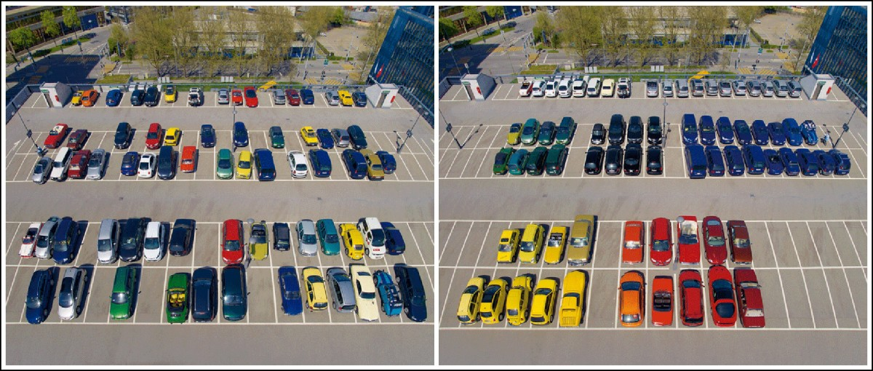
QA Services - Audit
Quality Team conducts the Audits to ensure the project compliance to the organizational set policies and processes.
Before audit
Audit Day
Notes:
Process assessments will not be a satisfactory substitute for software assessment. Audits are carried out typically to verify the conformance of the process followed while executing a project. An audit report typically helps the project team understand the inherent gaps in the process followed in the project and gives an opportunity to improve on the same.
Myth – my senior management will have sore eyes on me if my project has non-conformance
Mythbuster – Busted !! – There is adequate cooperation from senior management and QA team to help you bring your project on track to adhere process

Slide 47

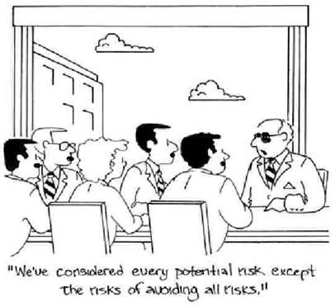
QA Services - Risk Management
We’ll be fooling ourselves if we are expecting a clear road ahead of us !!
Quality Team helps projects in identifying and mitigating the project risks.
Notes:
We’ll be fooling ourselves if we are expecting a clear road ahead of us !! Risks are part of project delivery. The way to mitigate and manage a risk differs from situation to situation. One solution does not apply for all.
Risk Review Criteria:
QA – i.e. offshore FTE ≥ 8; excluding Staff Aug./Capacity Cushion projects.
SBU/TLI delivery dashboards, CEO report (projects in Red/Amber from QA perspective), OTACE scores, self-assessment RATs, review requests from PMs/EMs/higher management – these are the main inputs for prioritizing and scheduling risk review.
Myth – There is no easy way to foresee project related risks !
Mythbuster – True. But we are always there to help !!

Slide 48
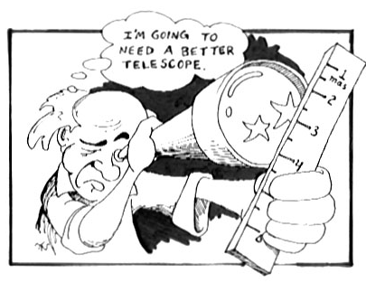
QA Services - Metrics
Less numbers and proactive metrics are only to save business risk. Expectation of quality models mostly contradict on this
Quality Team has set up a SQA team which will helps review and approval of the metrics for the projects and metrics council team establish baselines at an organizational level.
Notes:
Less numbers and proactive metrics are only save business risk. Expectation of quality models mostly contradict on this.
service quality is more difficult for the consumer to evaluate than product quality. Service quality perceptions result from a comparison of consumer expectations with actual service performance and Quality evaluations are not based solely on the outcome of a service but also involve evaluation of the delivery lifecycle
Myth – I can set up my own yardstick to guage my project
Mythbusteer – Busted !! – we have Organisation level benchmark available in Process Capability Baseline documents

Slide 49
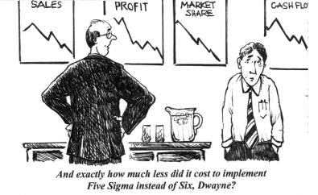
QA Services - Six Sigma
Is there really a big difference between 99.0% & 99.9996%?
Six Sigma is methodology adopted in engagement which would help to reduce defects.
Notes:
The most distinguishing feature of 6 Sigma – is that it is a Data Driven. Data drives every phase of the methodology. So if you have a problem and have no data and know the solution, don’t turn to Six Sigma because it is for solving problems where solutions are not known and where data can be accessed or collected.
It is a Business philosophy – putting customer’s first. How does that relate to Humana’s business philosophy (Perfect Service)?
Who has ever been to a foreign country where you did not know the native language very well? How easy was it to communicate and get things done? Talk about how Six Sigma is an cross-industry and actually an international improvement methodology. When we have Black Belts and Green Belts who join Humana, we can immediately talk to them in the same language around improvement methods and about tools used to understand and improve processes. Share an example where you have encountered this.
Lastly, six sigma is a universal measurement of performance based on defects per million opportunities. This allows us to take any process and convert it to a standard measure (million opportunities) so that we can compare any process and understand the defect rate.
Let’s try an example: If we have an error rate of 5% for one process, we can take .05 x one million and we know that our DPMO is ? (50,000). So for every million claims we process, 50,000 are defective. And if we have an error rate of 10% on another process, our DPMO would be?(100,000)
Most companies now view it as a business strategy and a methodology for improving process performance in such a way that customer satisfaction is increased and the bottom line is improved.
It is a managerial initiative AND a set of methods and tools
Initiative:
Improvement
Breakthrough
Systematic, Focused Approach
Right Projects linked to business goals
Right People selected and trained
Project Management and Reviews
Sustain the Gain with New Projects
Results – Process and Financial
Methods and Tools:
Process Thinking
Process Variation
Facts, Figures, Data
DMAIC
DFSS (DMADV)
Statistical Tools
Statistical Software
Critical Few Variables

Slide 50
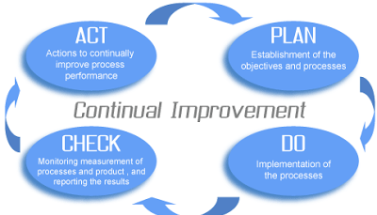
Continuous Improvement – PDCA Cycle
In Capgemini, we follow PDCA cycle for continuous improvement
Below are some of the activities through with we achieve continuous improvement in Capgemini.
Automation – Metrics Submission through PMTS
Industrialization: Code Quality Improvement
FMEA Implementation
PM Workshop, CM Workshops, Rapid Start Workshop
iCompass for Skills and Competency Assessment
Process Model for prediction
Notes:
Project planning and resource management are crucial elements for a successful project delivery. Standard quality principles assist you to in your planning activities and guide you in the right direction.
Myth – Project planning is the responsibility of project manager alone. I don’t have a role to play in it
Mythbuster – Busted !! – Although the overall plan is owned by the project manager, all project stakeholder contribute to project planning.

Slide 51
Agenda
Introduction – Concepts of Quality
QMS, Its Components & Navigation
Deliver (Global QMS)
KM Portal – Best Practice/Sample Records Database
Tools Quality Implementation at Capgemini
Our Continual Quality Journey…
Industry Standards
QA Team
Walkthrough of Basic Templates
Case Studies & Games
Notes:
Here is the agenda for today’s session.
We will be going through some generic terminologies, Quality terminologies, QMS & Its components, QMS Portal, The Global QMS i.e Deliver, The Best practice /sample records database KM Portal, We will look at the Capgemini recommended tools, Capgemini Quality Journey, Industry Standards, India QA Department – Its structure & services, Walkthrough of some basic templates, why to capture efforts, defects etc…
We will also be taking you through some case studies and games related to QMS.

Slide 52
Walkthrough of Basic Templates - CLARITY
Opening a Timesheet in Clarity
Different Scenarios for Filling up of Timesheets
Task Assigned to the Resource
Task not Assigned to the Resource
Submitting Timesheets

Slide 53
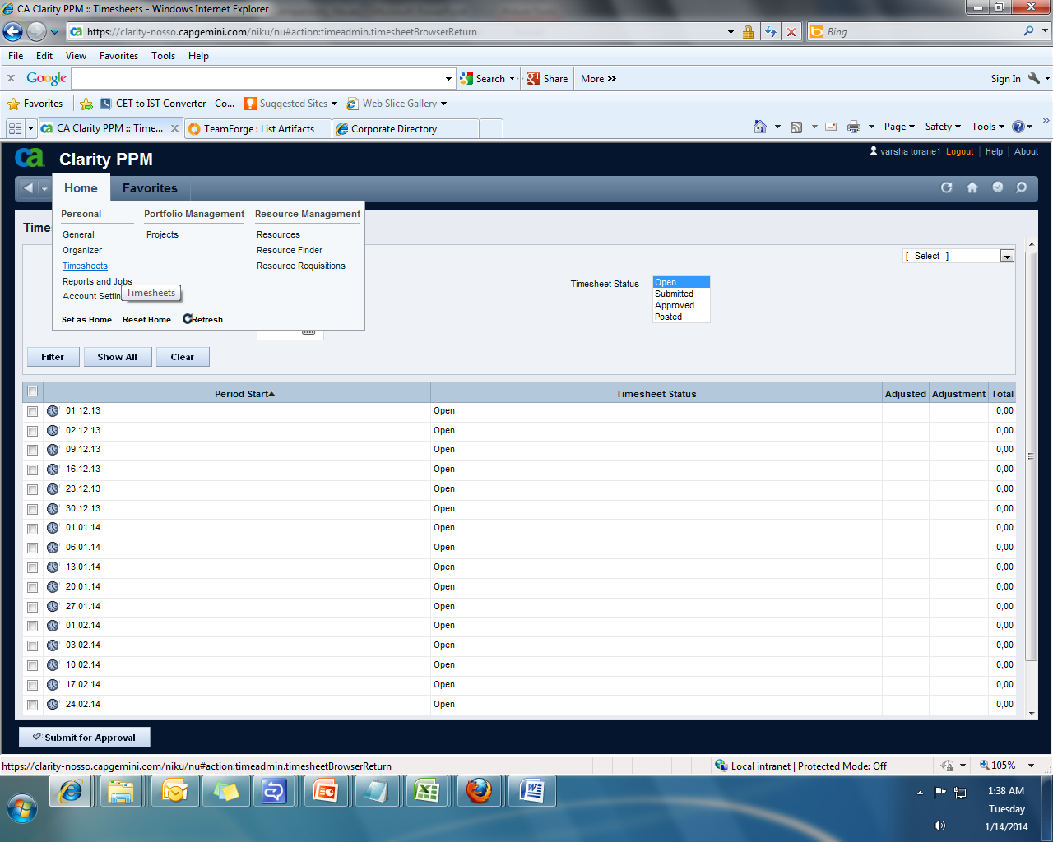
Walkthrough of Basic Templates - CLARITY Continued…
Opening a Timesheet in Clarity
Click the timesheets link under Home tab
Click the on the clock icon of the timesheet group that contains the day against which you want to book time

Slide 54
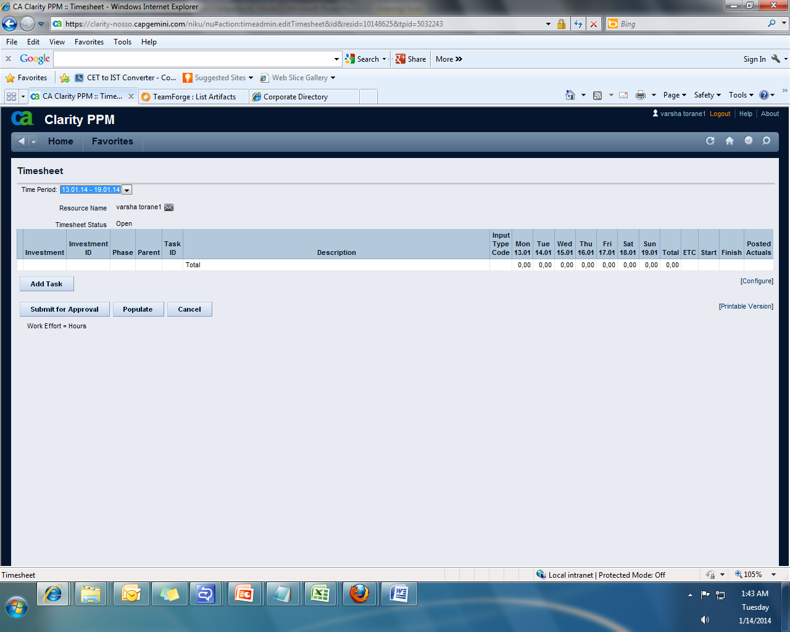
Walkthrough of Basic Templates - CLARITY Continued…
Once you open your timesheet by clicking on the clock icon of the timesheet group then the following screen will be displayed:

Slide 55
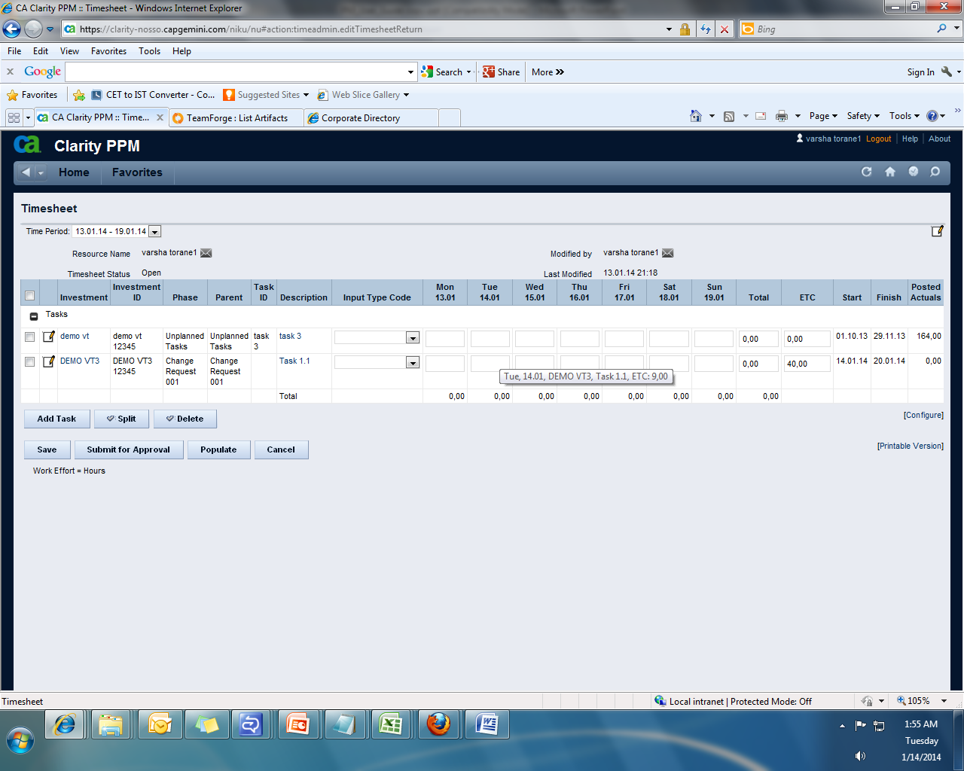
Walkthrough of Basic Templates - CLARITY Continued…
Task Assigned to the Resource
ETC is the time planned on this task
Click on this icon
to add a note
ETC is shown as a tooltip
Clicking on Populate, populates all the tasks in the timesheet that are assigned to you as below
Click on the task name to see the start date and end date of the task.
You can now enter the time for the tasks assigned to you

Slide 56
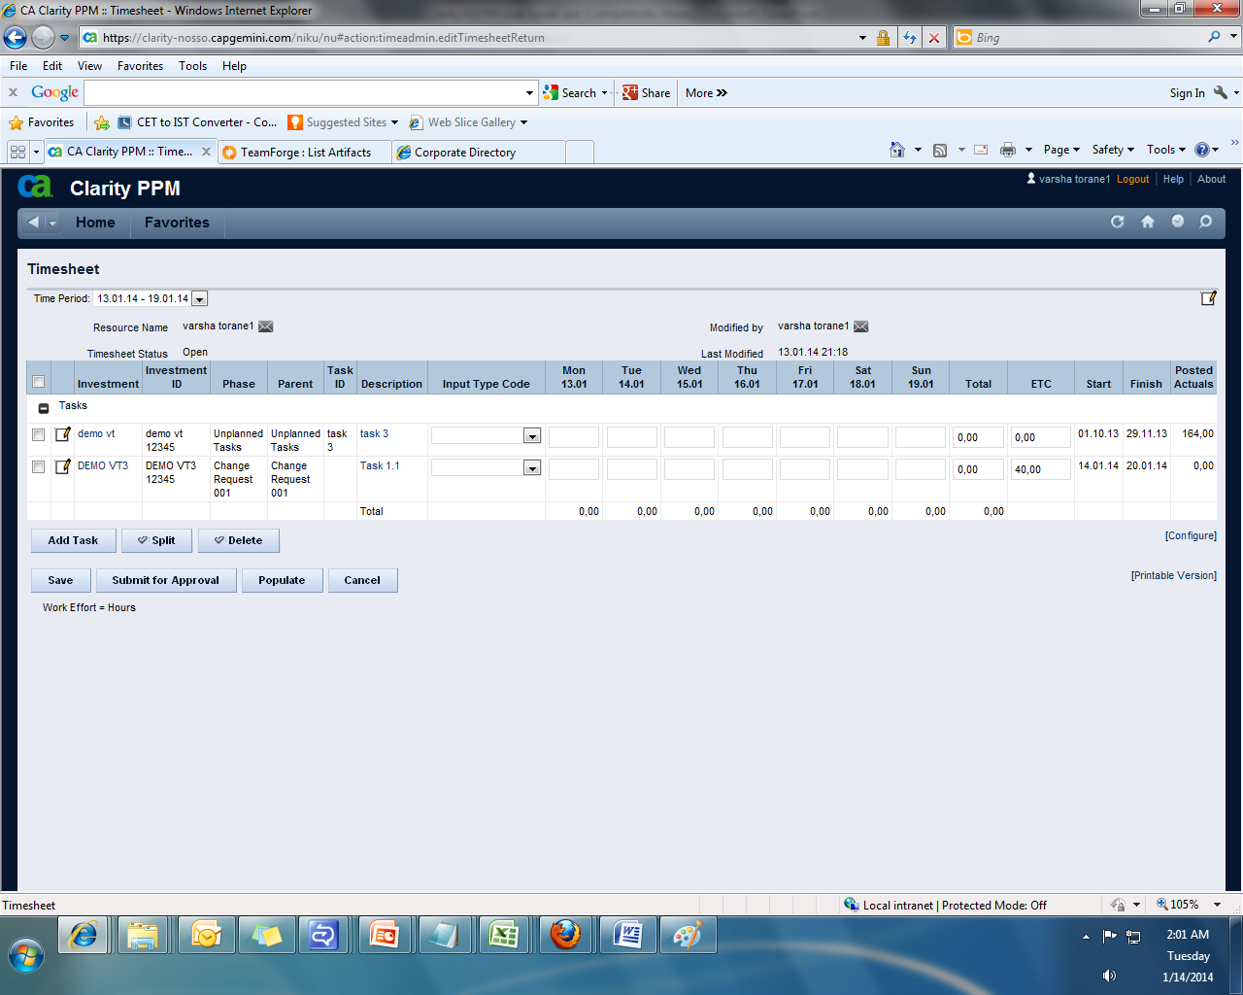
Walkthrough of Basic Templates - CLARITY Continued…
Task Not Assigned to the Resource
After you populate, click the “Add Task” tab. This will take you to the following screen

Slide 57
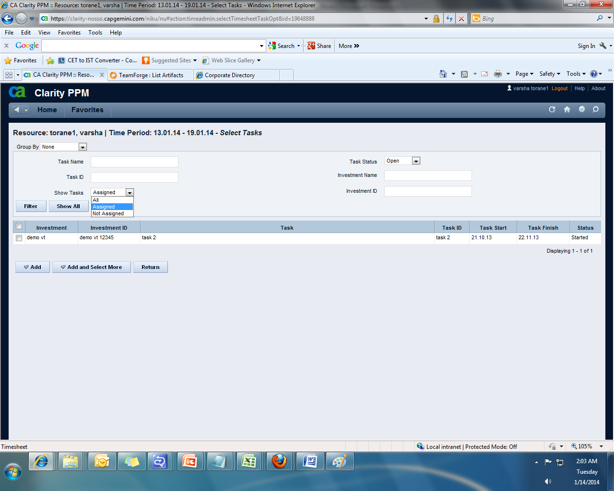
Walkthrough of Basic Templates - CLARITY Continued…
Task Not Assigned to the Resource
Can group by Task Hierarchy to see the Hierarchy above the task
From the drop down in the above snapshot select “Not Assigned” and click filter
On doing so, you will get a list of tasks that were not assigned to you.
Check the check box next to the task against which you want to fill time and then click Add this will add this task to your timesheet enabling you to enter time against this task.

Slide 58
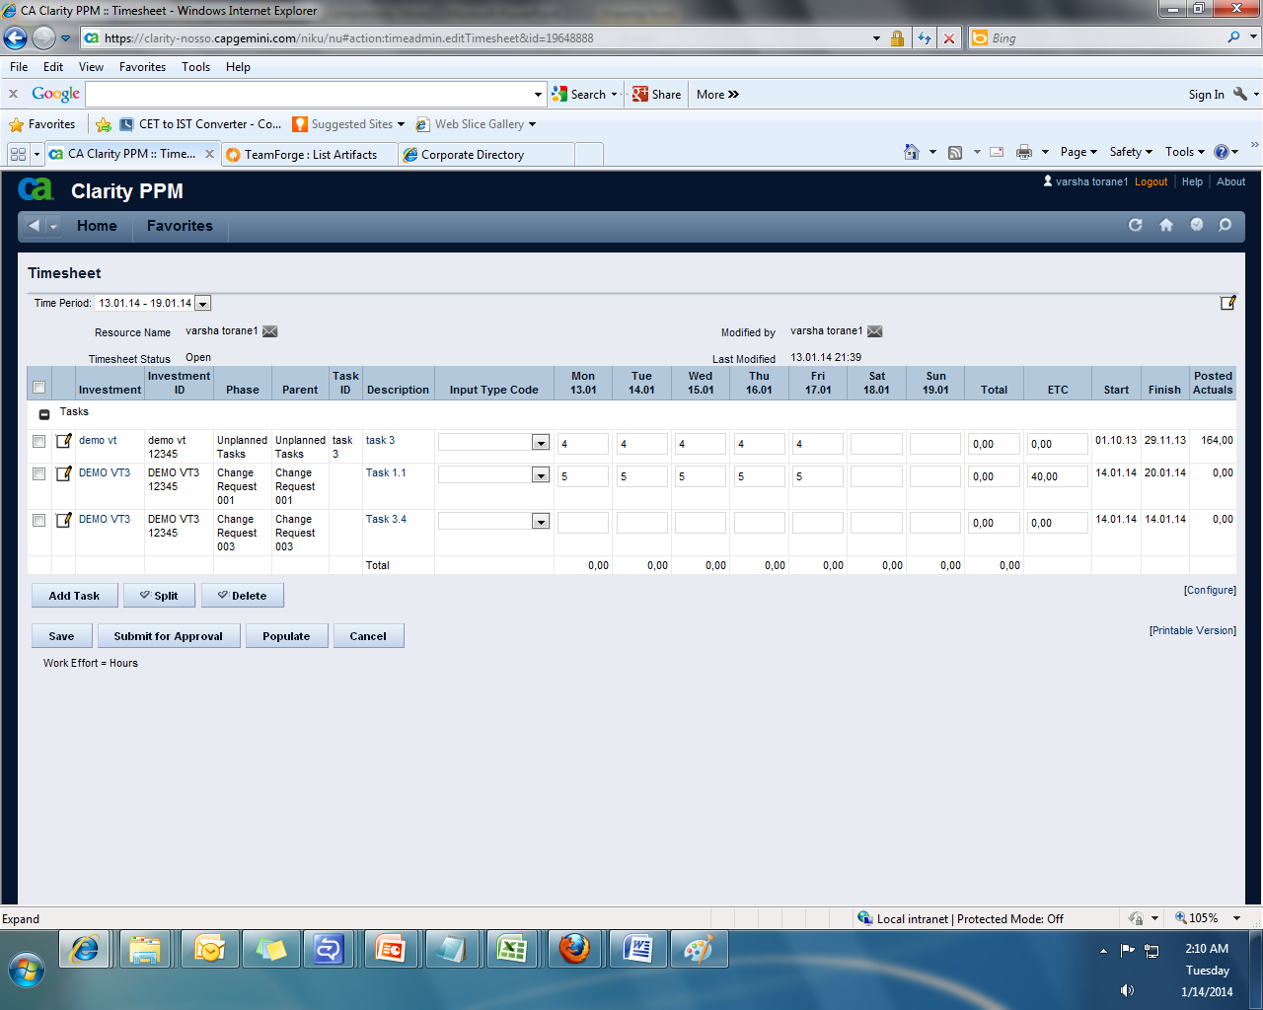
Walkthrough of Basic Templates – CLARITY Continued…
Submitting the Timesheet
After you fill the timesheet click on Submit for Approval
In order to book time daily one can save the timesheet and submit it at the end of the week
Once you save or submit it, it will deduct the number of hours in ETC column with the time you have already entered and at the same time the total number of hours that you have already entered will be shown in the total column

Slide 59
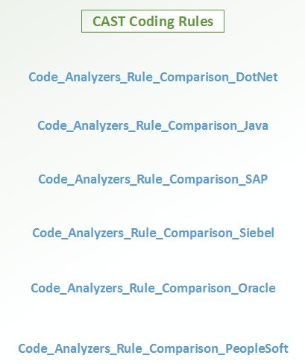
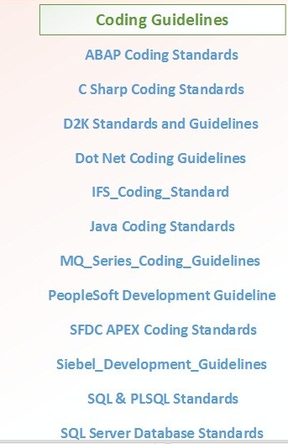
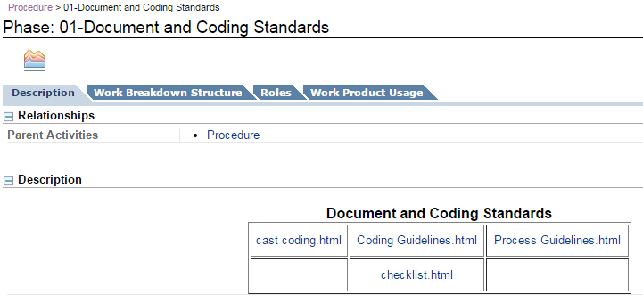
Walkthrough of Basic Templates - Coding Standards & Guidelines
Coding Standards & Guidelines
Coding standards for different technologies are available and they can be found in QMS at: QMS > Processes > QMS Processes > Document & Coding Standards > Description page provides the links as below.

Slide 60
Walkthrough of Basic Templates – DEFECT LOG
Defect Log Template Sections
Defect ID
Title
Description
Date Detected
Detected By
Detected Where
Root Cause
Category
Impact
Priority
Status
Date Last Status Change
Owner
Defect Resolution Actions
Estimated Cost
Target Resolution Date
Comments
Actual Resolution Date
Actual Cost
Sign-Off

Slide 61
Walkthrough of Basic Templates
Logging Incident & Problem Tickets

Slide 62
Why Capture Efforts?
Tasks
Size
Estimated Effort
Time Sheet Entry
Actual Efforts
Actual Dates
Metrics (Output):
Productivity (Size/Actual Efforts)
Effort Variance (Difference/Estimated Efforts)
Effort Distribution Across Phases
Cost of Quality (Prevention Cost+Appraisal Cost+Failure Cost)
Efforts Estimation for remaining Size can be done.
Notes:
This slide talks about why to capture the efforts.
By capturing the size of the task, estimated effort, actual effort and actual dates… we are going to get the below matrics which will be used to monitor and track the progress of the project/enagement.
Metrics:
Productivity (Size/Actual Efforts)
Effort Variance (Difference/Estimated Efforts)
Effort Distribution Across Phases
Cost of Quality (Prevention Cost+Appraisal Cost+Failure Cost)

Slide 63
Why to Capture Defects?
Tasks
Size
Timesheet
Actual Efforts
Defect Entry
Defects - No., Severity
Stage - Introduced & Detected
Error Category
Root Cause
Metrics (Output):
Defect Density (No. of Defect / Actual Size)
Defect Detection Rate (No. of Defect / Person Days)
Avg. Defect Age (depends on Stage detected & injected)
Defect Removal Efficiency (Pre-delivery & Post-delivery defect comparison)
Defects estimation for remaining size can be done.
Notes:
This slide talks about why to capture the defects.
By capturing the size of the task, actual effort, no. of defects, severity, stage, error category, root cause etc.. we are going to get the below metrics which will be used to monitor and track the progress of the project/engagement, identify process improvements etc...
Metrics (Output):
Defect Density (No. of Defect / Actual Size)
Defect Detection Rate (No. of Defect / Person Days)
Avg. Defect Age (depends on Stage detected & injected)
Defect Removal Efficiency (Pre-delivery & Post-delivery defect comparison)

Slide 64
Agenda
Introduction – Concepts of Quality
QMS, Its Components & Navigation
Deliver (Global QMS)
KM Portal – Best Practice/Sample Records Database
Tools Quality Implementation at Capgemini
Our Continual Quality Journey…
Industry Standards
QA Team
Walkthrough of Basic Templates
Case Studies & Games
Notes:
Here is the agenda for today’s session.
We will be going through some generic terminologies, Quality terminologies, QMS & Its components, QMS Portal, The Global QMS i.e Deliver, The Best practice /sample records database KM Portal, We will look at the Capgemini recommended tools, Capgemini Quality Journey, Industry Standards, India QA Department – Its structure & services, Walkthrough of some basic templates, why to capture efforts, defects etc…
We will also be taking you through some case studies and games related to QMS.

Slide 65
Case Studies & Games
TEAM GAME
Given below is a table with key words from quality, delivery, SDLC, certifications and organization level roles.
You can find the words arranged horizontally, vertically, diagonally or in a mirror image format. Find out the maximum words.
Y | C | M | M | I | S | S | U | E
T |  | E |  | D | T |  |  | G
I | T | F |  | P | M | I |  | R
L | I | F | E | C | Y | C | L | E
A | M | O |  | L | O | S | I | A
U | E | R |  | A | T | S | E | T
Q |  | T |  | R |  |  | T | S
M | C | A | R | I | S | K |  | A
S | E | P | G | T | A | S | K | C
P | M | T | S | Y | B |  | M | M

Slide 66
Case Studies & Games Continued..
TEAM GAME ANSWERS
QUALITY | ISO
COST | CMMI
TIME | ITIL
TEST | QMS
ISSUE | LIFECYCLE
RISK | PM
CAR | SEPG
EFFORT | TASK

Slide 67


Slide 68
Thank You

Slide 69
Revision History
Date | Version | Author | Description
14-Jul-2017 | 2.0 | QA Team | Slide 23 - Quality Policy is updated & OTACE fullform updated as per Bluebook Slide 29 - Replaced the QMS Screenshot Slide 34 - Updated the KM portal workflow to latest. Inserted revision history slide 69.

